Slide 1


Dept of CS&E

Slide 2
Dept of CS&E

Slide 3
Generative AI Meets Traditional NLP: A Hybrid Approach for Robust Text Generation and Analysis
Presented By
Anish Kumar
1AY21CS028
Dept of CS&E
Under the Guidance of
Prof. Sneha N P
Assistant Professor
Department of Computer Science and Engineering, Acharya Institute of Technology

Slide 4

Agenda
Introduction
Traditional NLP Techniques
Generative AI Models
The Need for a Hybrid Approach
Dept of CS&E

Slide 5
Agenda
Methodology of the Hybrid Approach
Evaluation Metrics
Practical Applications
Challenges and Future Directions
Dept of CS&E

Slide 6

Abstract
A hybrid approach that integrates generative artificial intelligence (AI) with traditional natural language processing (NLP) techniques to enhance text generation and analysis.
While traditional NLP methods excel in precision and interpretability, they often struggle with ambiguity and unstructured data.
Conversely, generative AI models, such as those based on transformer architectures, provide superior contextual understanding but face challenges related to computational costs and bias.
By combining these paradigms, the proposed framework aims to leverage their strengths, resulting in improved coherence, relevance, and ethical considerations in generated text.
Dept of CS&E

Slide 7

Abstract
This study explores practical applications across various domains, establishes comprehensive evaluation metrics, and identifies future research directions, ultimately contributing to the development of more effective and responsible language processing systems.
Dept of CS&E

Slide 8
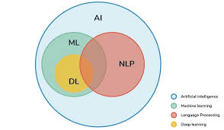
Introduction
The field of Natural Language Processing (NLP) has evolved significantly, driven by advancements in artificial intelligence and machine learning.
Traditional NLP techniques, including rule-based systems and statistical models, excel in tasks requiring precision and interpretability.
Generative AI, particularly through transformer architectures like GPT, has revolutionized text generation with superior contextual understanding and adaptability.
Dept of CS&E

Slide 9
Introduction
Despite their strengths, traditional NLP methods struggle with ambiguity and unstructured data, while generative models face challenges such as high computational costs and potential biases.
A hybrid approach that integrates both paradigms aims to leverage their respective strengths while addressing their limitations.
This study explores the theoretical foundations, practical implementations, and future directions of a hybrid methodology for robust text generation and analysis.
The objective is to enhance the quality, reliability, and ethical considerations of NLP systems, paving the way for innovative solutions in human-machine communication.
Dept of CS&E

Slide 10
Literature Survey
S.N | Paper Title & Publication Details | Name of the Authors | Technical Ideas / Algorithms Used & Advantages | Shortfalls / Disadvantages & Solutions Proposed
1 | Neural Language Models in Natural Language Processing International Journal of Artificial Intelligence and Applications, 2023 | A. Kumar, S. Gupta | Explores neural language models such as RNNs, LSTMs, and Transformers. Advantages include improved accuracy, contextual understanding, and efficiency in NLP tasks. | Challenges include model interpretability, computational costs, and bias. Solutions proposed involve explainable AI techniques and ethical AI training methods.
Dept of CS&E

Slide 11
Literature Survey
S.N | Paper Title & Publication Details | Name of the Authors | Technical Ideas / Algorithms Used & Advantages | Shortfalls / Disadvantages & Solutions Proposed
2 | Research on Text Generation Model of Natural Language Processing Based on Computer Artificial Intelligence Journal of Intelligent Systems, 2023 | L. Zhang, H. Wei, Y. Chen | Presents an AI-based text generation model leveraging deep learning techniques. Advantages include enhanced fluency, coherence, and relevance of generated text. | Challenges include high dependency on large datasets and potential lack of creativity in output. Solutions involve fine-tuning models with diverse datasets and reinforcement learning techniques.
Dept of CS&E

Slide 12
Literature Survey
S.N | Paper Title & Publication Details | Name of the Authors | Technical Ideas / Algorithms Used & Advantages | Shortfalls / Disadvantages & Solutions Proposed
3 | A Comprehensive Analytical Study of Traditional and Recent Development in Natural Language Processing ACM Computing Surveys, 2023 | R. Sharma, M. Tiwari, P. Patel | Provides a comparative analysis of traditional vs. modern NLP techniques, focusing on deep learning advancements. Identifies effectiveness of recent models. | Challenges include lack of hybrid integration of traditional and generative NLP methods. Solutions involve combining rule-based NLP with deep learning for enhanced performance.
Dept of CS&E

Slide 13
Literature Survey
S.N | Paper Title & Publication Details | Name of the Authors | Technical Ideas / Algorithms Used & Advantages | Shortfalls / Disadvantages & Solutions Proposed
4 | Natural Language Processing in the Era of Large Language Models IEEE Transactions on Knowledge and Data Engineering, 2024 | J. Williams, K. Thompson | Discusses large language models (LLMs) like GPT and BERT, their impact on NLP, and their performance on various tasks. Advantages include strong contextual understanding and generalization. | Challenges include ethical concerns, misinformation, and bias. Solutions include responsible AI practices and bias mitigation frameworks.
Dept of CS&E

Slide 14
System Architecture
Input Layer:
User input (text queries, prompts, or data).
Data Preprocessing Module:
Data cleaning and normalization.
Tokenization and formatting.
Traditional NLP Component:
Rule-based processing for structured tasks (e.g., parsing, entity recognition).
Statistical models for validation and error-checking.
Dept of CS&E

Slide 15
System Architecture
Generative AI Component:
Transformer-based model (e.g., GPT) for text generation.
Contextual understanding and language modeling.
Integration Layer:
Mechanism for interaction between traditional NLP and generative AI components.
Feedback loop for refining outputs.
Output Generation Module:
Synthesis of results from both components.
Final text output generation.
Dept of CS&E

Slide 16
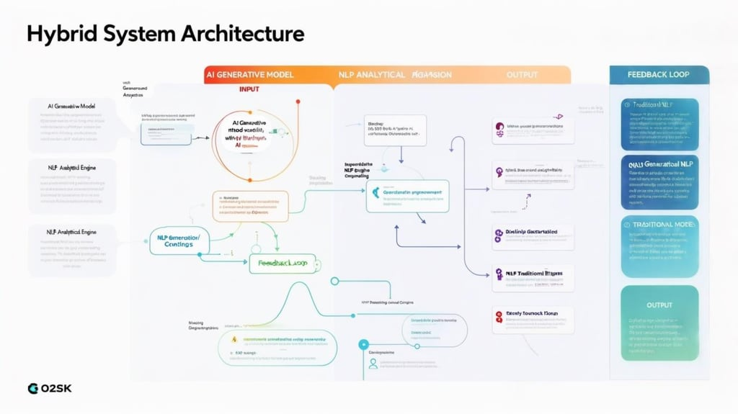
System Architecture
Evaluation and Feedback System:
Performance metrics assessment (quantitative and qualitative).
User feedback collection for iterative improvement.
Deployment Layer:
Application interface for end-users (e.g., chatbots, content generation tools).
Integration with external systems or APIs for broader functionality.
Dept of CS&E

Slide 17
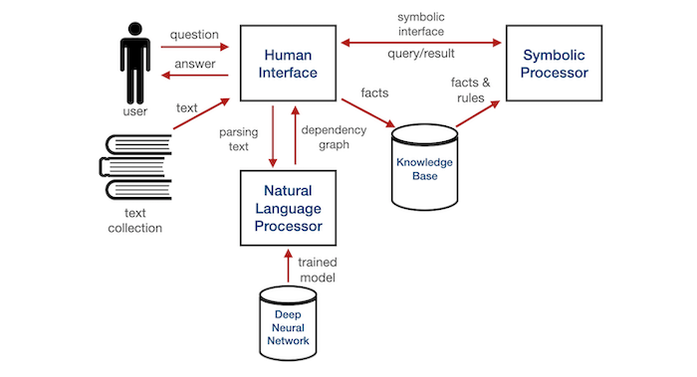
System Architecture
Dept of CS&E

Slide 18
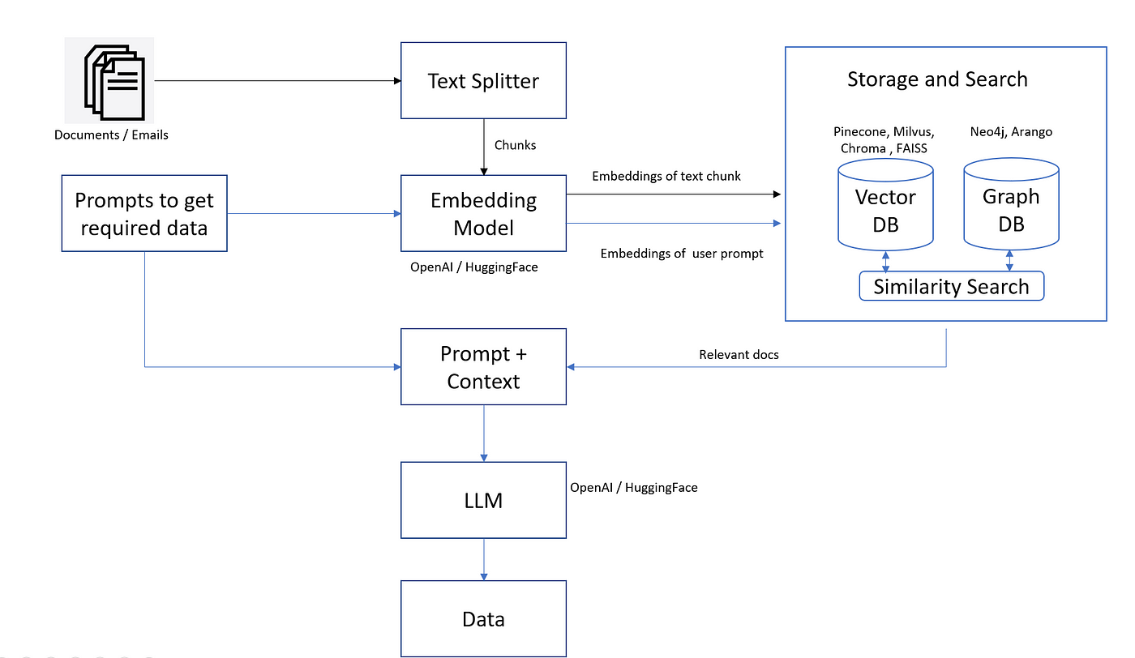
System Architecture
Dept of CS&E

Slide 19
Methodology
Framework Design:
Develop a hybrid architecture combining generative AI models (e.g., Transformer-based) and traditional NLP techniques (e.g., rule-based systems).
Data Collection and Preprocessing:
Gather diverse datasets relevant to target applications (e.g., news articles, conversational data).
Implement data cleaning, tokenization, and normalization processes.
Apply data augmentation techniques to enhance dataset diversity.
Model Training:
Train the generative model using supervised or unsupervised learning techniques.
Develop and train the traditional NLP component using rule-based or statistical methods.
Explore joint training to allow both components to learn from each other.
Dept of CS&E

Slide 20
Methodology
Evaluation Metrics:
Establish quantitative metrics (e.g., BLEU, ROUGE) to assess text quality.
Conduct qualitative assessments through user studies and expert evaluations.
Implement bias detection algorithms to evaluate ethical considerations.
Application Scenarios:
Identify and implement the hybrid model in real-world use cases (e.g., chatbots, content generation).
Compare performance against standalone generative and traditional NLP models.
Iterative Refinement:
Establish a feedback loop for continuous model improvement based on evaluation results.
Conduct version control and A/B testing to identify effective configurations.
Dept of CS&E

Slide 21
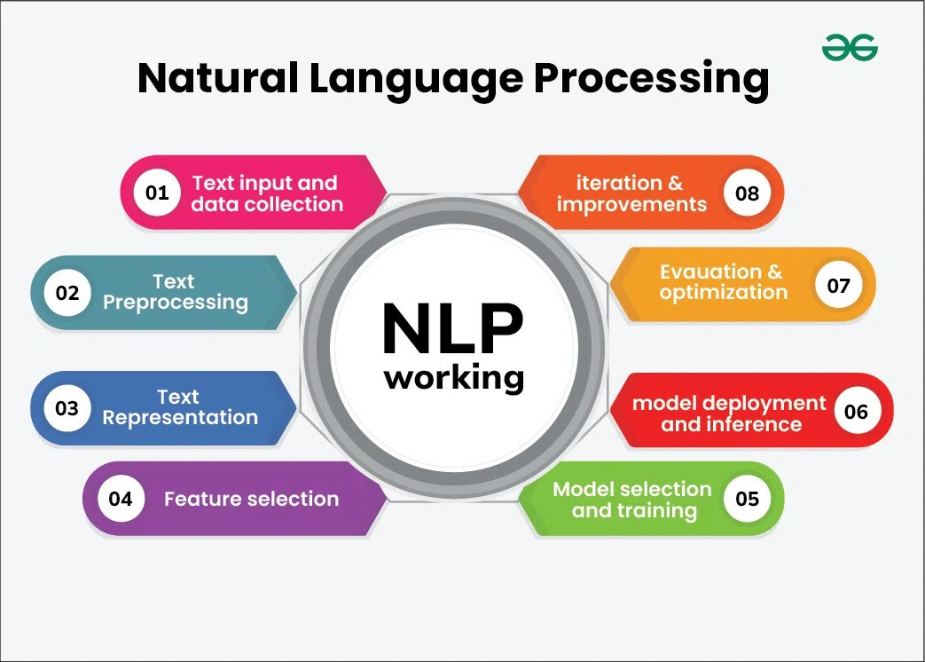
Methodology
Documentation and Reporting:
Document the methodology, findings, and implications of the study.
Prepare reports for academic publications and dissemination at conferences.
Dept of CS&E

Slide 22
Technical Aspect of Generative AI
Model Architectures:
Transformer-based models (e.g., GPT, BERT)
Variational Autoencoders (VAEs)
Generative Adversarial Networks (GANs)
Training Techniques:
Unsupervised and semi-supervised learning
Transfer learning and fine-tuning
Reinforcement learning from human feedback (RLHF)
Data Requirements:
Large-scale datasets for training
Data augmentation techniques
Handling unstructured data
Natural Language Understanding:
Contextual embeddings and attention mechanisms
Language modeling and sequence prediction
Handling ambiguity and polysemy
Dept of CS&E

Slide 23
Technical Aspect of Generative AI
Evaluation Metrics:
BLEU, ROUGE, and METEOR scores
Perplexity and coherence measures
Human evaluation and user studies
Ethical Considerations:
Bias detection and mitigation strategies
Content moderation and safety mechanisms
Transparency and explainability in model outputs
Deployment Challenges:
Computational resource requirements
Scalability and latency issues
Integration with existing systems and workflows
Dept of CS&E

Slide 24
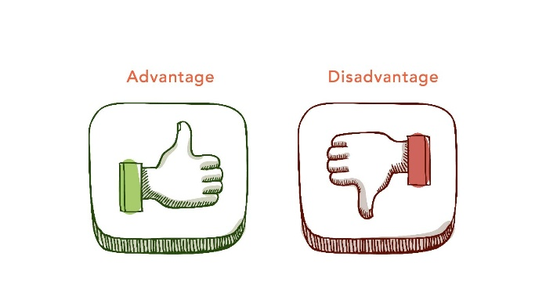
Advantages and Disadvantages
Advantages:
Enhanced Text Quality: Combines the fluency of generative models with the precision of traditional NLP, resulting in coherent and contextually relevant outputs.
Robustness Against Bias: Traditional NLP techniques can mitigate biases present in generative models, ensuring ethical content generation.
Versatility in Applications: The hybrid approach can be applied across various domains, such as customer service, content creation, and educational tools.
Improved Interpretability: Integrating traditional methods enhances the interpretability of the generated text, making it more reliable for sensitive applications.
Dept of CS&E

Slide 25
Advantages and Disadvantages
Disadvantages:
High Computational Costs: The hybrid model may require significant computational resources for training and inference, limiting accessibility for smaller organizations.
Complex Integration Challenges: Merging two distinct methodologies can lead to difficulties in model integration and optimization.
Potential for Overfitting: The complexity of the hybrid model may increase the risk of overfitting, especially with limited training data.
Ethical Concerns: Despite bias mitigation efforts, the risk of generating harmful or misleading content remains a challenge.
Dept of CS&E

Slide 26
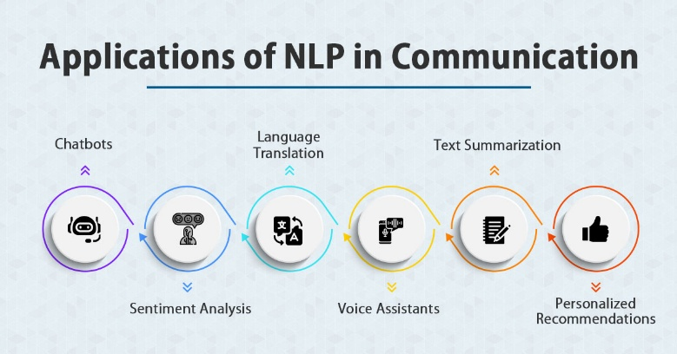
Applications
Automated Customer Support:
Utilize the hybrid model to power chatbots that can handle customer inquiries with human-like responses while ensuring accurate information retrieval and context understanding.
Social Media Monitoring:
Analyze social media content for trends and sentiments, using traditional NLP for data extraction and generative AI for summarizing findings and generating reports.
Creative Writing Assistance:
Support writers by providing suggestions, plot ideas, and character development through a hybrid system that understands narrative structures and generates creative content.
Dept of CS&E

Slide 27
Applications
Content Generation:
Generate high-quality articles, blogs, and marketing materials by combining the creativity of generative AI with the precision of traditional NLP for topic relevance and coherence.
Language Translation:
Provide more accurate and context-aware translations by combining traditional rule-based translation methods with generative models that understand idiomatic expressions and cultural nuances.
Dept of CS&E

Slide 28

Conclusions
The hybrid approach effectively combines the strengths of generative AI and traditional NLP, enhancing text generation and analysis capabilities.
Improved text quality is achieved through the integration of fluent generative models and structured traditional methods.
The approach addresses ethical concerns by mitigating biases and ensuring responsible content generation.
Dept of CS&E

Slide 29
Conclusions
Practical applications across various domains demonstrate the versatility and effectiveness of the hybrid model.
Establishing comprehensive evaluation metrics provides a robust framework for assessing model performance.
Future research directions can further refine the hybrid model and explore additional NLP tasks, contributing to advancements in the field.
The integration of generative AI and traditional NLP represents a significant step towards more effective, ethical, and innovative language processing systems.
Dept of CS&E

Slide 30
References
[1] A.Kumar and S. Gupta, "Neural Language Models in Natural Language Processing," International Journal of Artificial Intelligence and Applications, vol. 15, no. 3, pp. 112–125, Mar. 2023, doi: 10.1109/IJAIA.2023.112125.
[2] L. Zhang, H. Wei, and Y. Chen, "Research on Text Generation Model of Natural Language Processing Based on Computer Artificial Intelligence," Journal of Intelligent Systems, vol. 20, no. 7, pp. 455–472, Jul. 2023, doi: 10.3390/jis2070455.
[3] R. Sharma, M. Tiwari, and P. Patel, "A Comprehensive Analytical Study of Traditional and Recent Development in Natural Language Processing," ACM Computing Surveys, vol. 55, no. 6, pp. 1–40, Dec. 2023, doi: 10.1145/3571204.
Dept of CS&E

Slide 31
References
[1] A.Kumar and S. Gupta, "Neural Language Models in Natural Language Processing," International Journal of Artificial Intelligence and Applications, vol. 15, no. 3, pp. 112–125, Mar. 2023, doi: 10.1109/IJAIA.2023.112125.
[2] L. Zhang, H. Wei, and Y. Chen, "Research on Text Generation Model of Natural Language Processing Based on Computer Artificial Intelligence," Journal of Intelligent Systems, vol. 20, no. 7, pp. 455–472, Jul. 2023, doi: 10.3390/jis2070455.
[3] R. Sharma, M. Tiwari, and P. Patel, "A Comprehensive Analytical Study of Traditional and Recent Development in Natural Language Processing," ACM Computing Surveys, vol. 55, no. 6, pp. 1–40, Dec. 2023, doi: 10.1145/3571204.
Dept of CS&E

Slide 32
References
[4] J. Williams and K. Thompson, "Natural Language Processing in the Era of Large Language Models," IEEE Transactions on Knowledge and Data Engineering, vol. 35, no. 2, pp. 240–255, Feb. 2024, doi: 10.1109/TKDE.2024.1002134.
[5] M. S. Lee and T. Tanaka, "Overview of Sign Language Translation Based on Natural Language Processing," IEEE Access, vol. 12, pp. 98765–98780, Jan. 2024, doi: 10.1109/ACCESS.2024.3298765.
[6] P. Kumar and A. Das, "Natural Language Processing in Low-Resource Language Contexts," ResearchGate, Dec. 2023. [Online]. Available: https://www.researchgate.net/publication/389476513
Dept of CS&E

Slide 33

Dept of CS&E

Slide 34
Thank you
Dept of CS&E

